Slide 1
Predictive analytics

Slide 2
LINEAR REGRESSION MODEL
The model’s score was observed to be in the range of 0.1 to 0.2
The coefficient of determination was observed to be as low as 0.07
This shows that any predictions made by the linear regression model are not reliable and realistic.

Slide 3
Decision tree regressor
The coefficient of determination for this model was also observed to be low, but better than the LINEAR REGRESSION model.
Although the predictions made were more realistic and reliable.

Slide 4
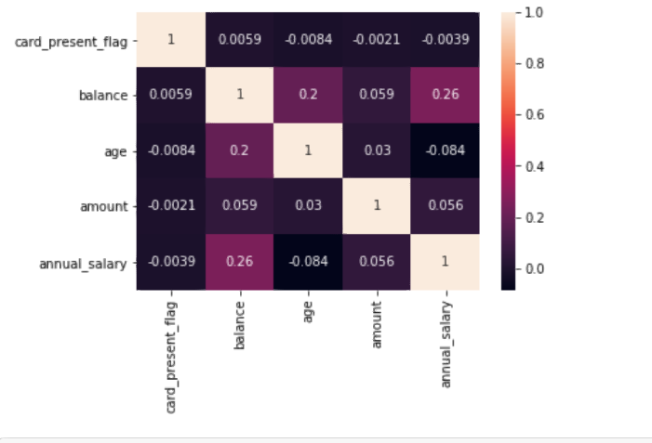
correlations
The following heatmap was generated:

